Slide 1
UASRM:
U-Net Audio Spectrogram Repair Model
Todd Goldfarb
Oregon State University
tcgoldfarb@gmail.com
goldfart@oregonstate.edu

Slide 2
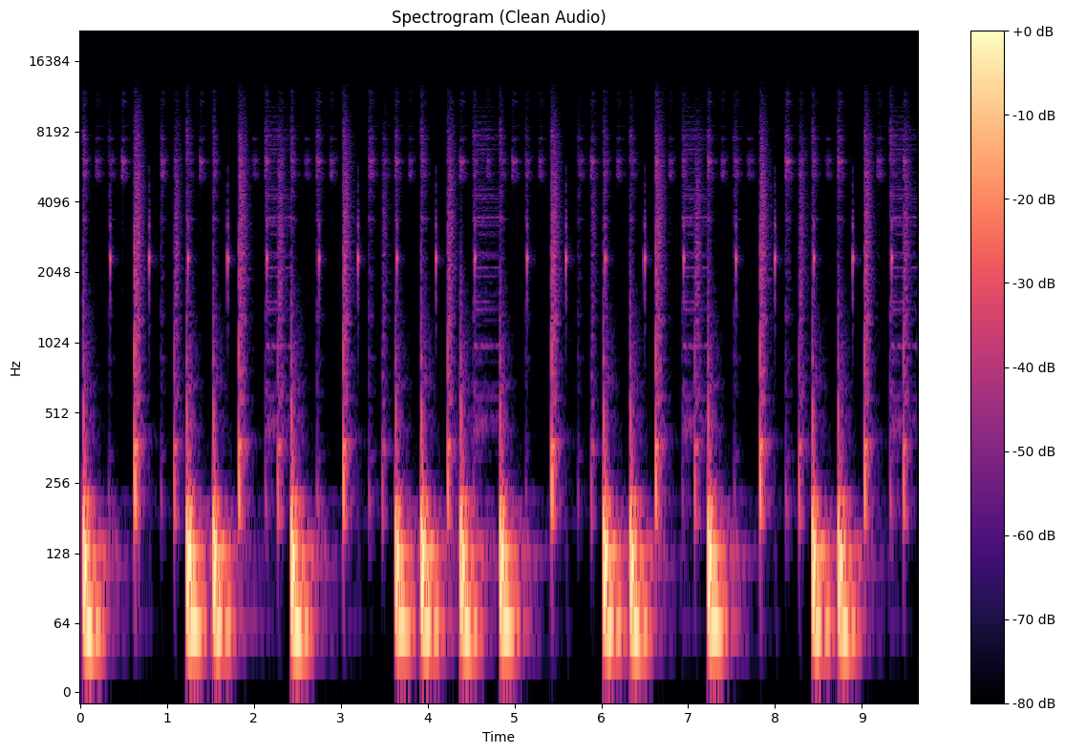
Audio in a Visual Format
Spectrograms are a visual representation of audio.
PREPROCESSING:
.wav (wave) -> 2D Raw Audio Array
Raw 2D Array -> Spectro. (STFT)
Spectro -> Tensors
This whole process is reversed to output to audio.

Slide 3
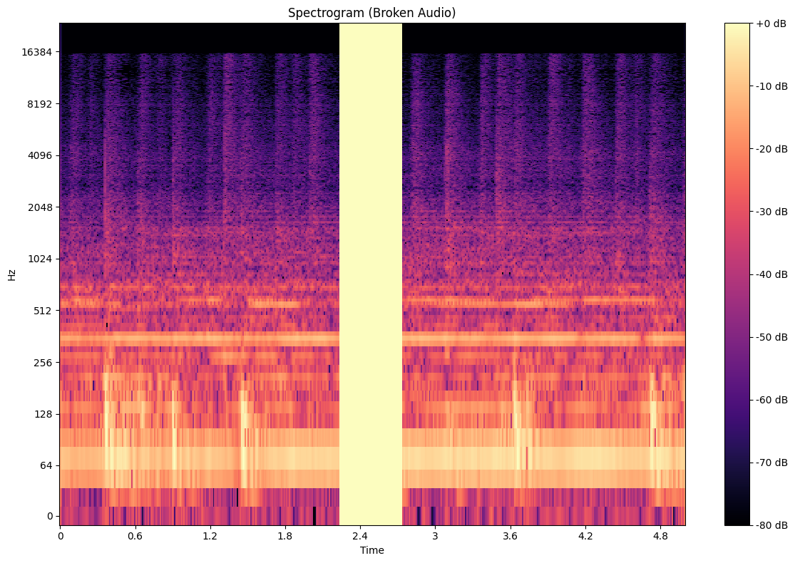
Damaged Audio and Machine Learning Reconstruction
Global and local knowledge – how would you fill in the spectrogram to the right?
Image inpainting is very popular in machine learning.
Given that a spectrogram is an image – is there a methodology we could use that could “inpaint” that audio using the context around it and other damaged spectrograms?

Slide 4
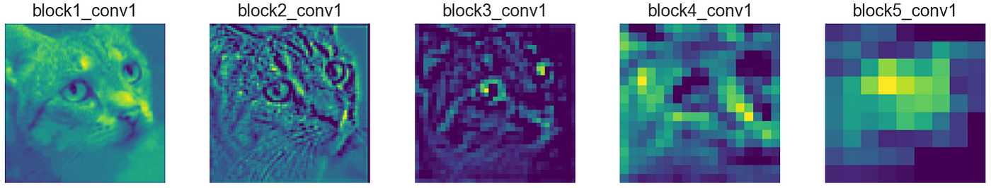
Feature Maps and Convolutional Layers
Convolutional Layer
A trained “filter” over an image, that can either downscale or upscale an image, extracting features (which can be learned to extract certain features)
Convolutional Blocks
A set of convolutional layers.
Feature Map
The output of a convolutional layer, used to “fill in gaps” for inpainting (in our case).

Slide 5
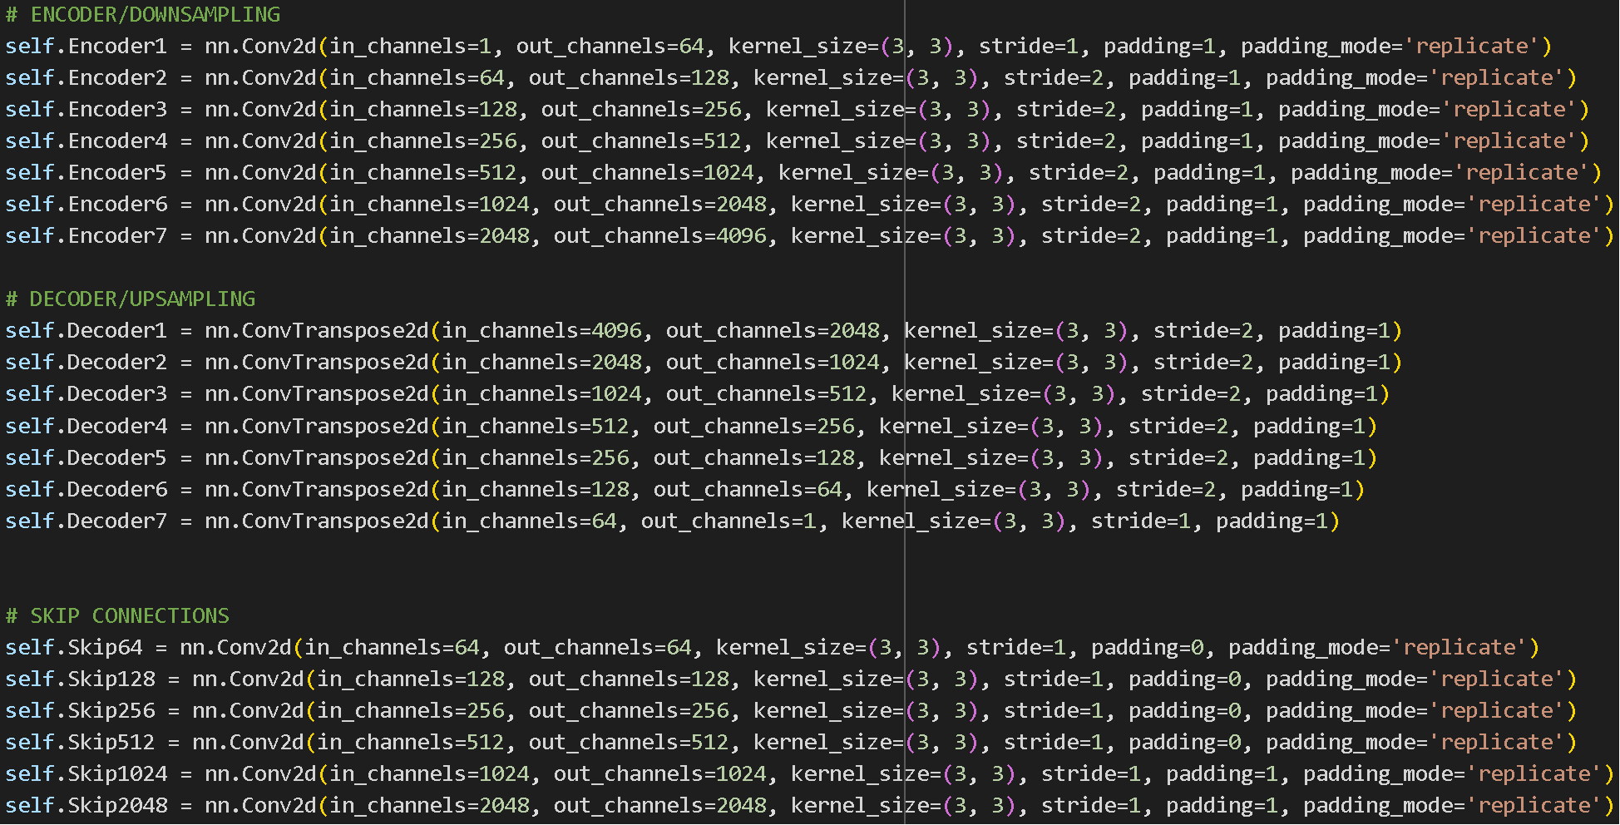

Slide 6
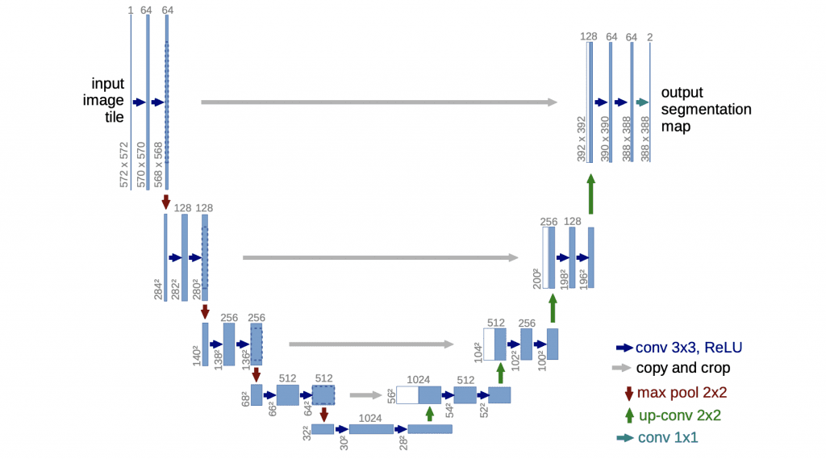
The “U-Net” Structure
The output is then calculated against a “non-damaged” version of the audio and the loss is calculated.
This loss (calculated using MSELoss) is then used for backpropagation.
The model tries an attempt, is told how “close” it is (loss), and attempts again and again, improving each time.

Slide 7
No More Theory – The Actual Model
Data pipeline that takes a selection of wave (.wav) files, and creates a dataset (artificially damaging/removing audio and pairing with clean audio).
Modified U-Net Architecture model that creates a feature map up to 4096 channels, using Skip Connections (64, 128, 256, 512, 1024, 2048).
The forward output is spliced at the damaged points of the audio and returned to the original spectrogram (only “filling in” data at specified damage intervals).
The model is trained over the damaged and clean audio dataset, and then uses MSELoss for backpropagation.

Slide 8
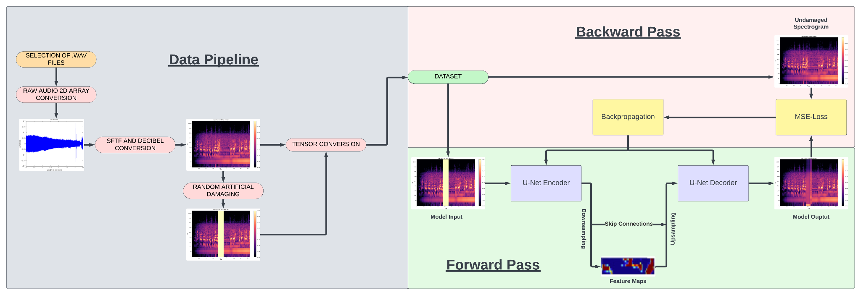
(split into 5 second chunks)

Slide 9
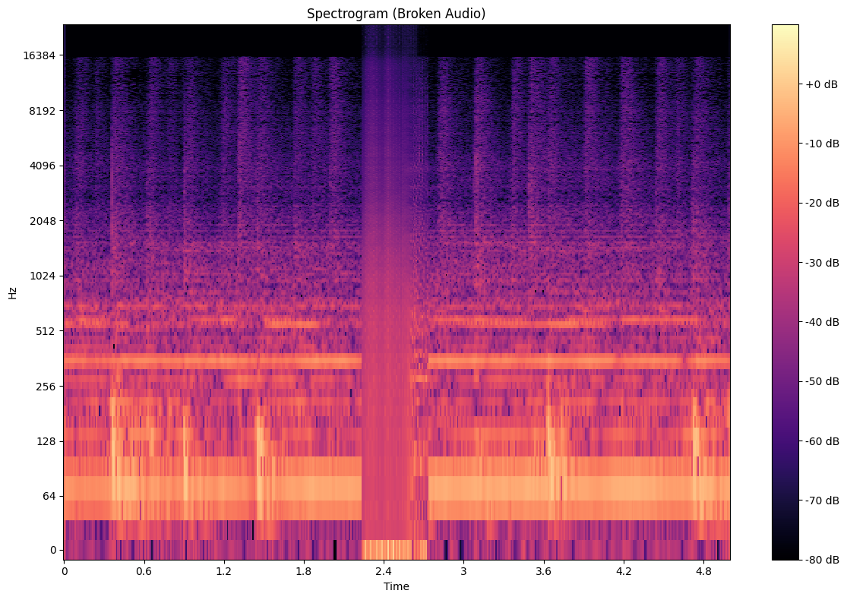
Example (Complex Audio)
Damaged Input
Restored Output

Slide 10
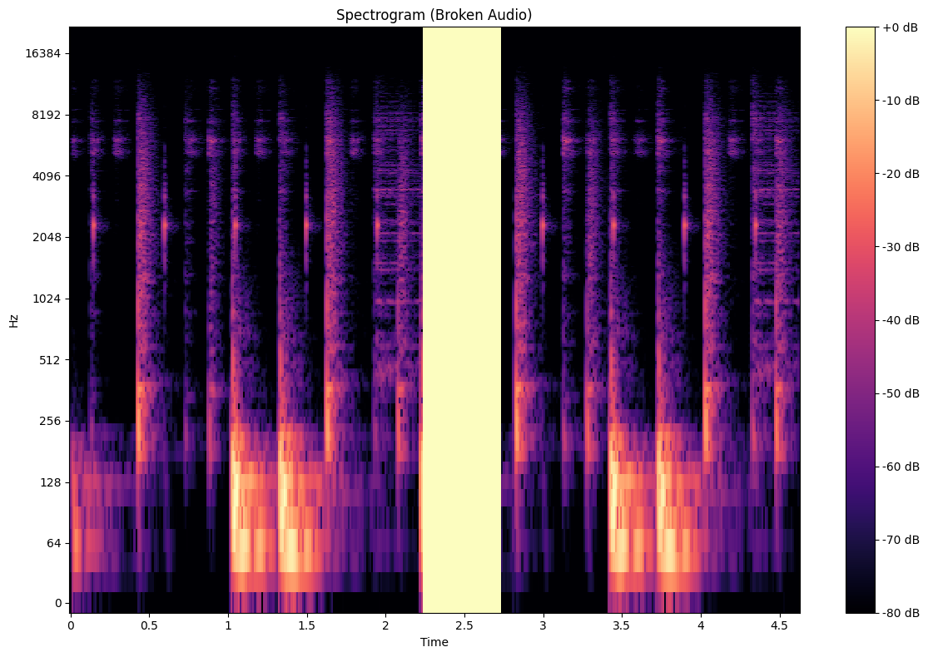
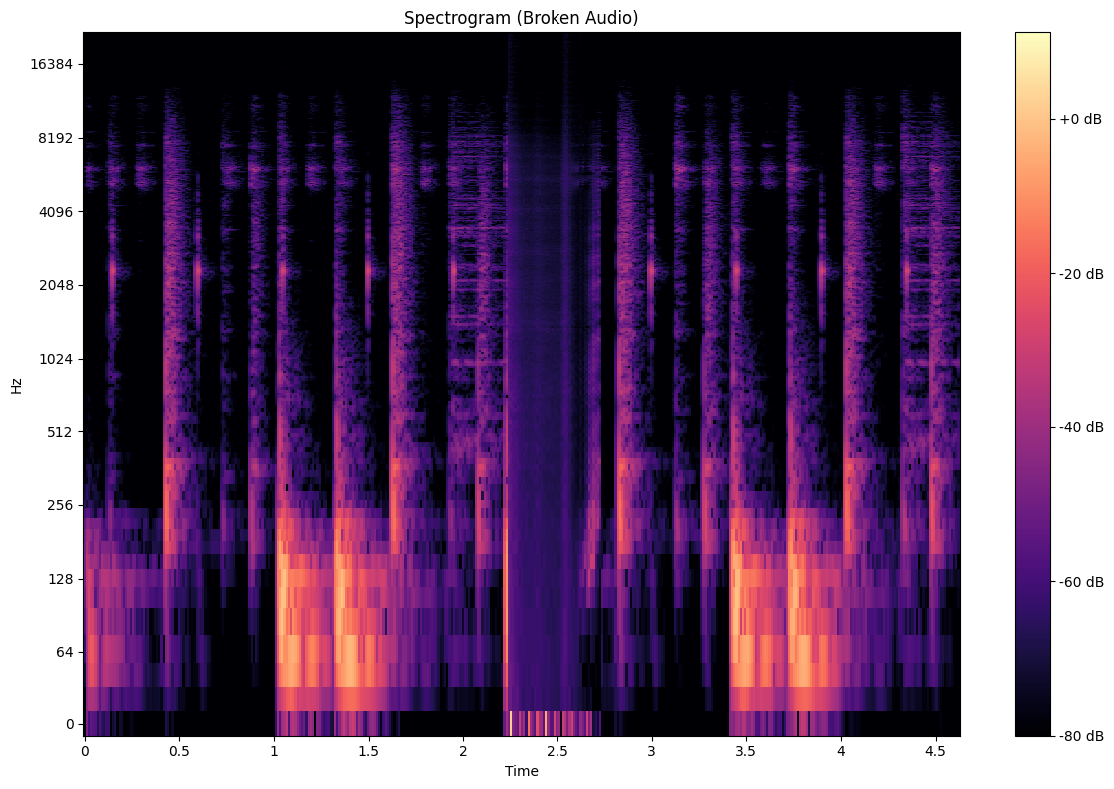
Example (Simpler Audio)
Damaged Input
Restored Output

Slide 11
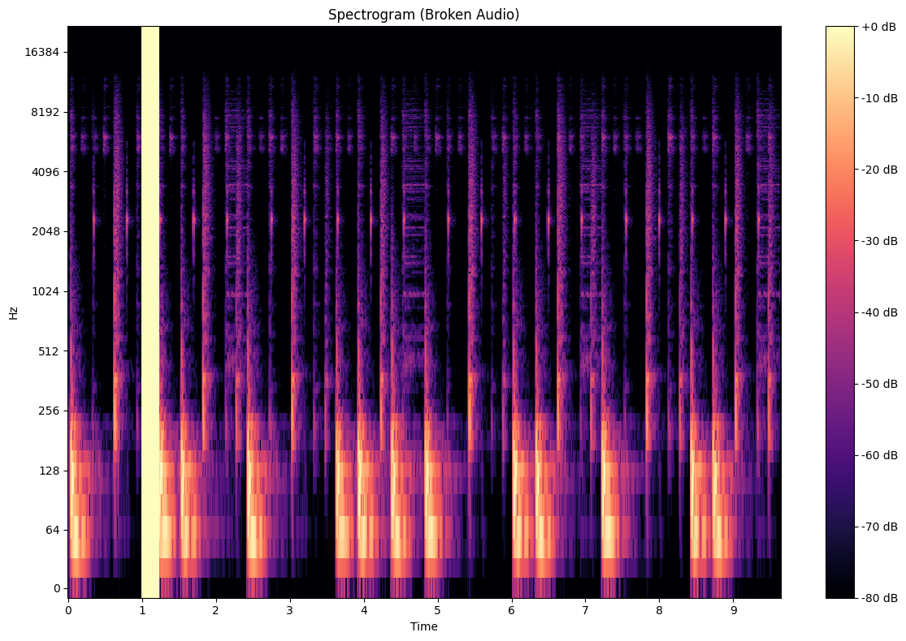

Example (Simpler Audio, More Context)
Damaged Input
Restored Output

Slide 12
Damaged Input
Restored Output

Slide 13
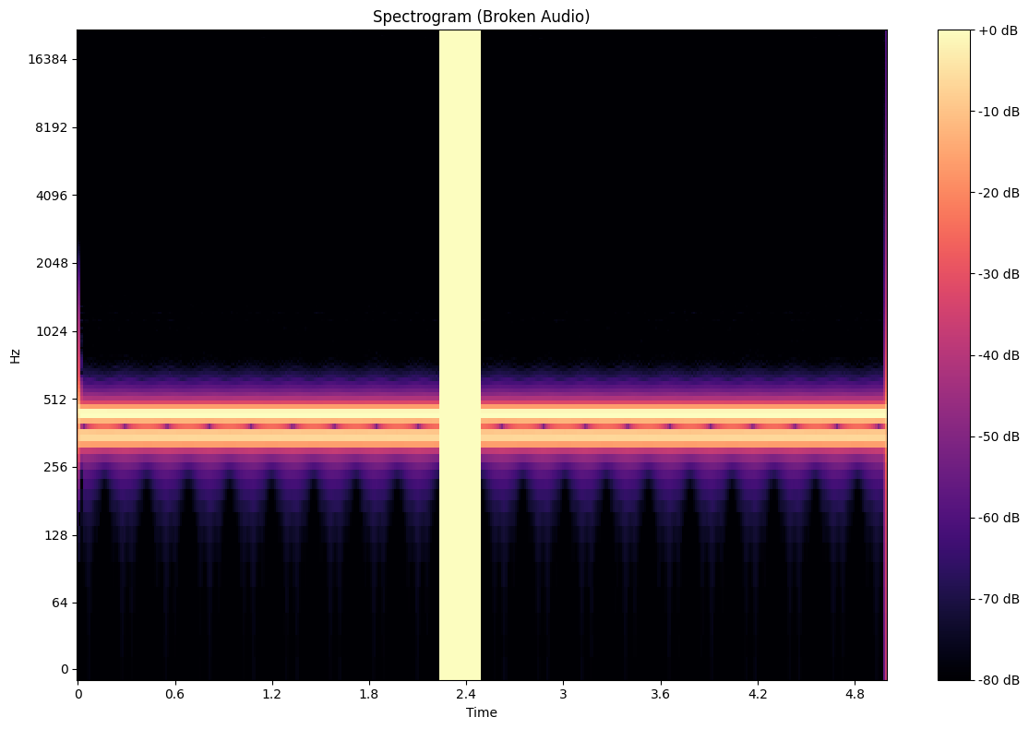
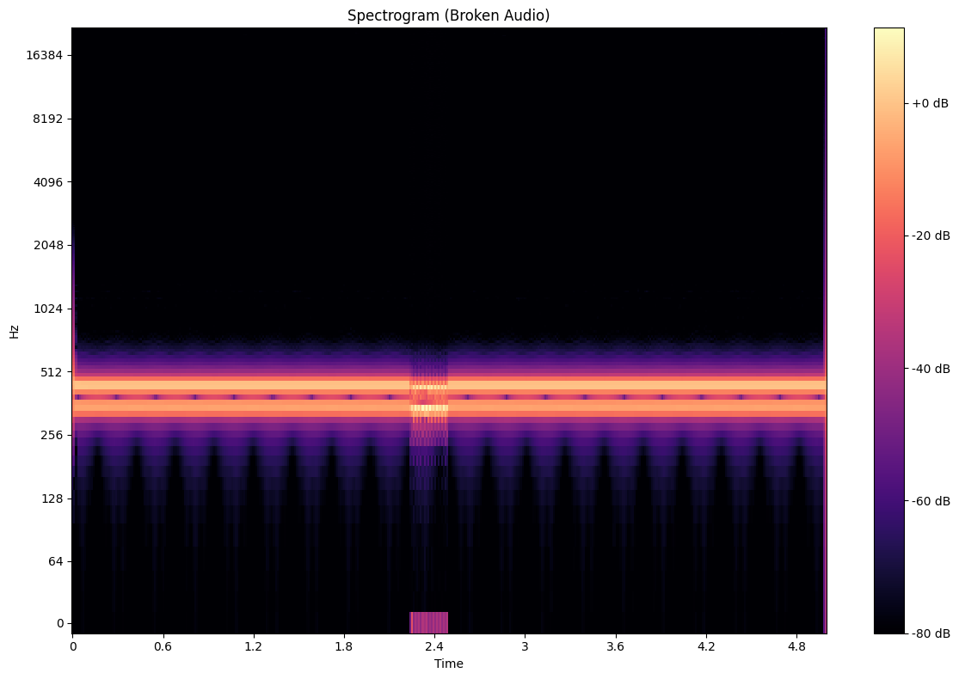
Example (Simplest Audio)
Damaged Input
Restored Output

Slide 14
Outputs and Results
The audio can be reconstructed on audio files larger than ~4 seconds, with best results at about 0.1-0.5 seconds reconstructed at a time.
Given the “conceptual nature” of the model and lack of huge dataset/processing power to train on the dataset, as well as the relatively small model size, I’m very happy with what it can do.
On Canvas/In Zoom, if you are curious, there should be a list of audios (clean and model reconstructed) to listen to.

Slide 15
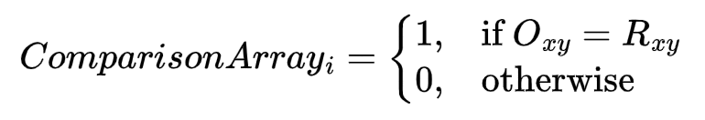
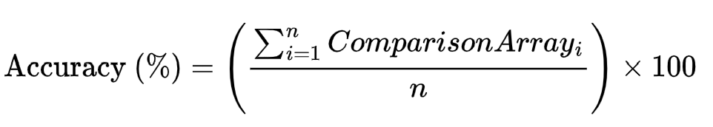
Quantitative Metrics
It largely depends on certain factors (input damage, input length, dataset trained). These metrics are based on a “tough” scenario: 5 seconds of context input, 0.5 seconds of damage. Dataset = 1,000 total samples (augments included). Smaller damages (0.15s) can get upwards of 95% acc.
Using element-wise comparisons:
Simple Audio (Tones/Single Sounds):
ACCURACY RANGE: ~65%-75%
Compound Audio (Two Threads+ Sound):
ACCURACY RANGE: ~60%-67%
Complex Audio (Music + Vocal + SFX):
ACCURACY RANGE: ~52%-61%

Slide 16
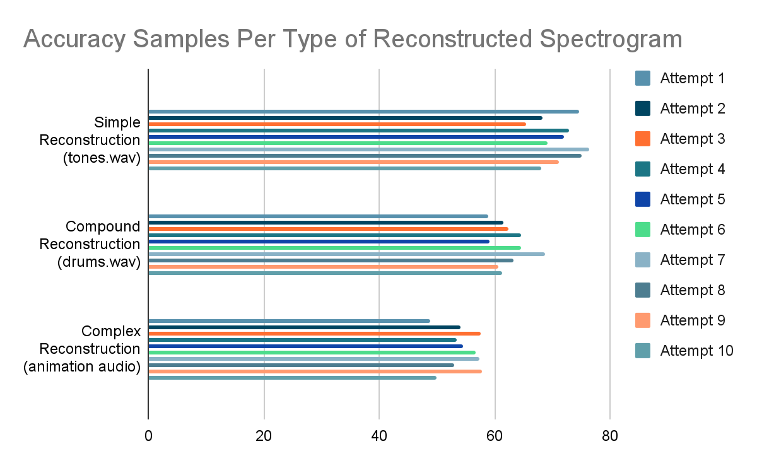

Slide 17
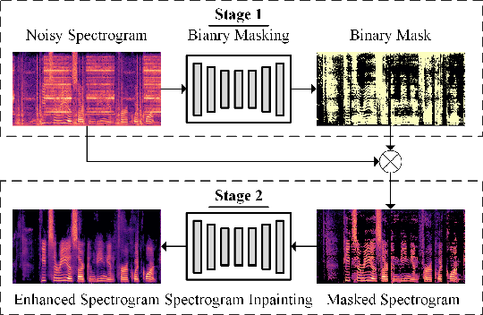
Looking Forward
Past just a “conceptual” practice model, how could this be improved for genuinely powerful audio repair?
Bigger Model (More convolutional layers = bigger content affect reach)
Larger and more varied dataset (Better global understanding)
Conditional Generative Adversarial Network (cGAN) approach?
Address the padding 0s side effect. (Inaudible, but still present)

Slide 18
